Slide 1
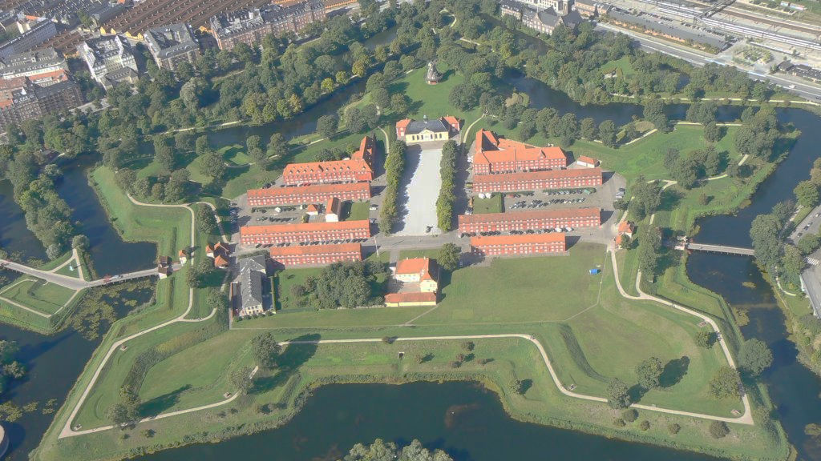

SECURE. PRIVATE. UNTRACEABLE.
Copenhagen, Denmark

Slide 2
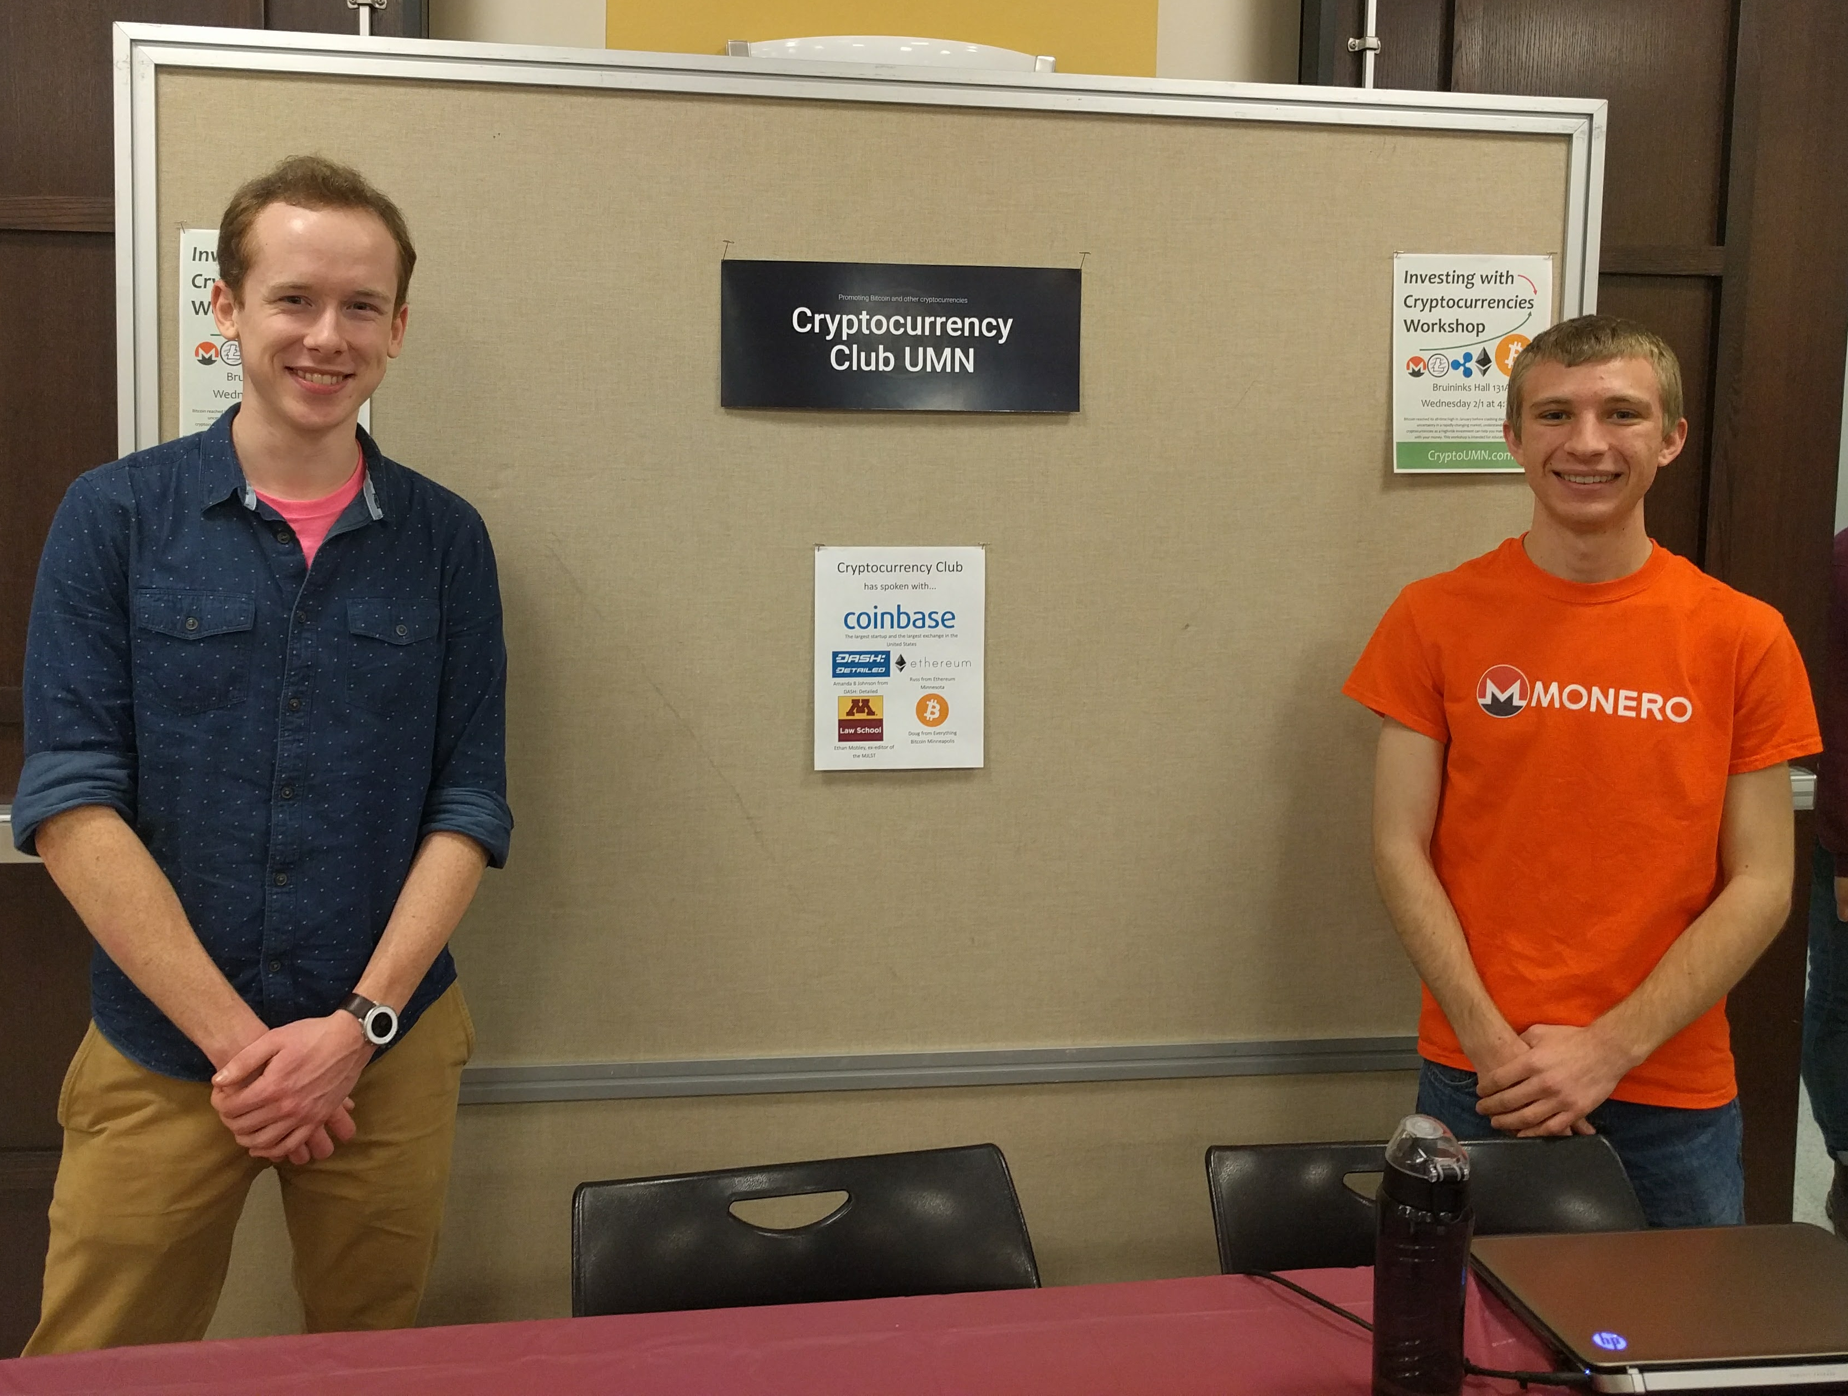


Welcome
Justin Ehrenhofer
Finance
Management Information Systems
/u/SamsungGalaxyPlayer or sgp_
CryptoUMN.com

Slide 3

People Started Adding Tools to Bitcoin

Slide 4
People Started Adding Tools to Bitcoin
Notes:
CoinJoin requires other participants to mix with. DASH, which built its PrivateSend functionality on CoinJoin, requires at least 3 participants. The service performing the functionality, whether it is a centralized server for Bitcoin or a randomly-selected masternode for DASH, can log what money goes where.

Slide 5
People Started Adding Tools to Bitcoin
Notes:
CoinJoin requires other participants to mix with. DASH, which built its PrivateSend functionality on CoinJoin, requires at least 3 participants. The service performing the functionality, whether it is a centralized server for Bitcoin or a randomly-selected masternode for DASH, can log what money goes where.

Slide 6
The Monero Difference
SENDER
AMOUNT
TRANSACTION
BROADCAST
RECEIVER
ɱ
RING
SIGNATURES
RING CONFIDENTIAL
TRANSACTIONS (RINGCT)
KOVRI
(I2P ROUTER)
STEALTH
ADDRESSES

Slide 7
Ring Signatures & RingCT
8 (Tx ID hng6iwfumwf8)
8 (Tx ID hng6iwfumwf8)
15 (Tx ID wn3f4diiijffwn)
1 (Tx ID e4hn4ifqyd5ed)
15 (Tx ID wn3f4diiijffwn)
2 (Tx ID eshgni5lsvnf74)
9 (Tx ID cb8vqfi8dfj65f)
16 (Tx ID 5 f8wnfdmmii)
3 (Tx ID wb4f5hdfdicnd)
10 (Tx ID fnidmfnu3dm8)
17 (Tx ID h8fn5mdfi4w)
4 (Tx ID nh5nogsefwjw)
11 (Tx ID twv8mf8dnfas)
11 (Tx ID twv8mf8dnfas)
18 (Tx ID n48gfwmfdki)
BLOCKCHAIN
18 (Tx ID n48gfwmfdki)
5 (Tx ID fgwinw3fwtk54)
5 (Tx ID fgwinw3fwtk54)
12 (Tx ID h5o8mfdngkd)
19 (Tx ID fnidmnfdsam)
6 (Tx ID ybwnng8nengf)
13 (Tx ID 7nr8mrjffijdtm)
20 (Tx ID t4vn8lf8djer4)
7 (Tx ID e4bgn8flwwrj8)
14 (Tx ID f8n8madkrjmd)
21 (Tx ID 4f5f8njdoam4)
21 (Tx ID 4f5f8njdoam4)

Slide 8
Ring Signatures & RingCT
INPUTS
5 (Tx ID fgwinw3fwtk54)
8 (Tx ID hng6iwfumwf8)
11 (Tx ID twv8mf8dnfas)
Ringsize = 6
Minimum September 2017*
15 (Tx ID wn3f4diiijffwn)
Minimum Today
18 (Tx ID n48gfwmfdki)
21 (Tx ID 4f5f8njdoam4)
key image

Slide 9
Ring Signatures & RingCT
Pedersen commitment
rCT = x*G + a*H(G)
INPUTS
Random Number
Actual Amount
5 (Tx ID fgwinw3fwtk54)
5 (Tx ID fgwinw3fwtk54)
8 (Tx ID hng6iwfumwf8)
8 (Tx ID hng6iwfumwf8)
RingCT ring signature, signs difference between commitments
11 (Tx ID twv8mf8dnfas)
11 (Tx ID twv8mf8dnfas)
Ringsize = 6
15 (Tx ID wn3f4diiijffwn)
Minimum September 2017*
15 (Tx ID wn3f4diiijffwn)
? XMR
18 (Tx ID n48gfwmfdki)
Minimum Today
18 (Tx ID n48gfwmfdki)
Commitment public key
21 (Tx ID 4f5f8njdoam4)
21 (Tx ID 4f5f8njdoam4)
key image

Slide 10
Ring Signatures & RingCT
INPUTS
5
8
Older
Newer
11
15
Coinbase Transaction
(New Money)
Input Actually
Spent
Someone Else
Borrowed Input
18
21

Slide 11
How Inputs Are Selected
Time Since Last Spent
ENTIRE BLOCKCHAIN
AT LAUNCH
CURRENT (IMPROVED TRIANGULAR DISTRIBUTION)
IDEAL

Slide 12

12.154.85.166
ORIGIN
NODE
Tx ID: 375wd4h
LOGGING
NODE

Slide 13
3dsnf28.i2p
ORIGIN
NODE
Tx ID: 375wd4h
LOGGING
NODE

Slide 14
Stealth Addresses
INPUTS
OUTPUTS
Commitment public key
hfk5yndjdmnfirwm5dnu
Back to Sender
7yf8dji8fbwb4f5hdfdicnd
? XMR
ey5f8ne58nh5nogsefwjw
OR
58fmd8jhybwnng8nengf
100 XMR
5hfnq835hng6iwfumwf8
3348dqnqcb8vqfi8dfj65f
To Receiver

Slide 15
Summary
hfk5yndjdmnfirwm5dnu
5 (Tx ID fgwinw3fwtk54)
7yf8dji8fbwb4f5hdfdicnd
8 (Tx ID hng6iwfumwf8)
ey5f8ne58nh5nogsefwjw
11 (Tx ID twv8mf8dnfas)
? XMR
58fmd8jhybwnng8nengf
15 (Tx ID wn3f4diiijffwn)
5hfnq835hng6iwfumwf8
18 (Tx ID n48gfwmfdki)
3348dqnqcb8vqfi8dfj65f
21 (Tx ID 4f5f8njdoam4)
Commitment public key

Slide 16
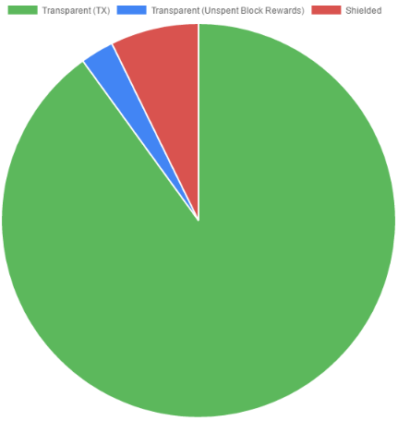
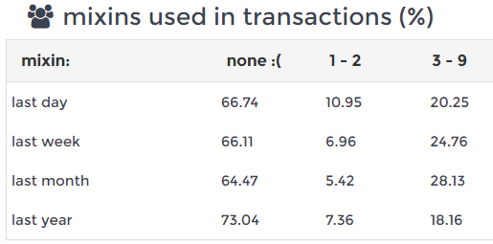
Mandatory Privacy
Source: MoneroBlocks.info 24 Feb 2016
Source: zcha.in 15 March 2017

Slide 17
A Brief History
Feb Critical Vulnerability Patched
March All Tx Private
Apr Launched
Dec GUI Beta 1
Sept Attacked
Jan MRL-0004
Apr Hardfork
2015
2016
Jan RingCT
2014
2017
Adapted from Scott Anecito’s Presentation

Slide 18
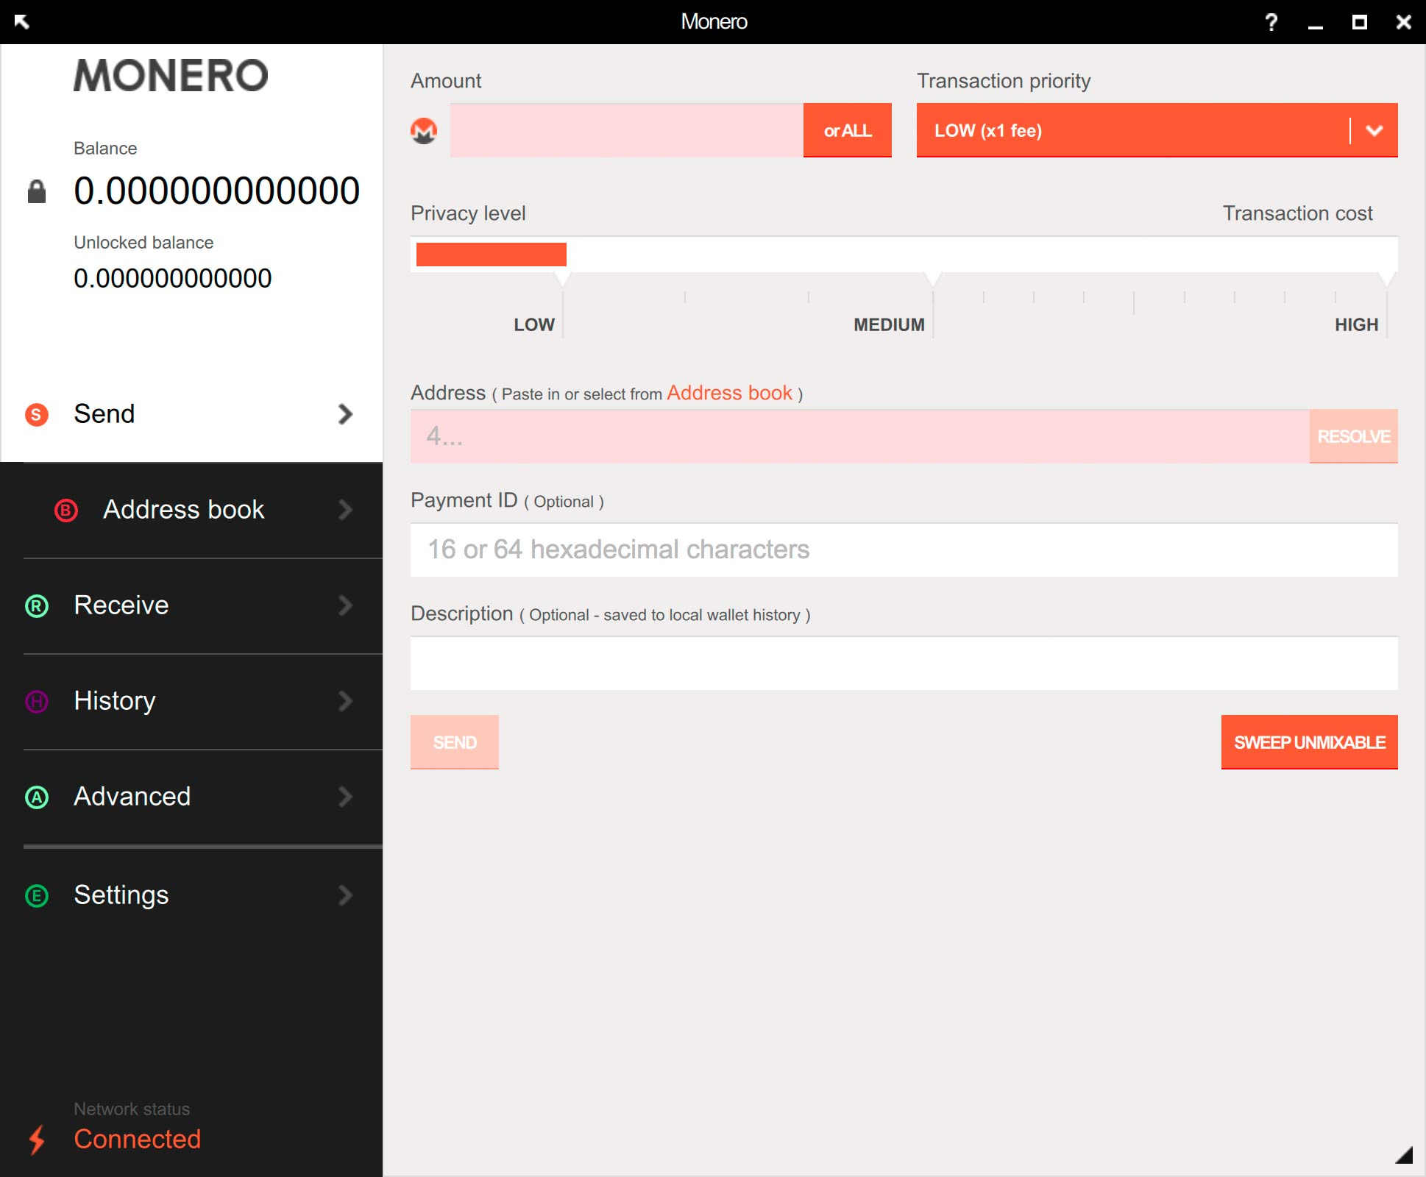
The Infamous GUI

Slide 19
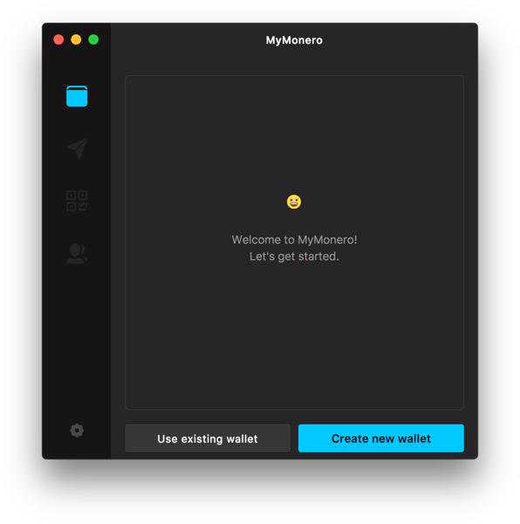
MyMonero Lightweight Wallet

Slide 20
Regulatory Compliance and Transparency
(with the View Key)
Transparency
Selected Parties
Charities
Parents
A view key is used to reveal all transactions for a Monero account, or just the key for a single transaction
View keys can be given to selected parties, or can be made public
By publishing their view key, charities can invite easy public oversight
Children can be given their own accounts, and parents can monitor their spending
Adapted from Riccardo Spagni’s Presentation

Slide 21
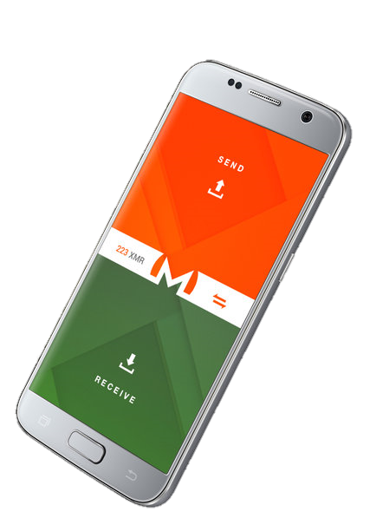
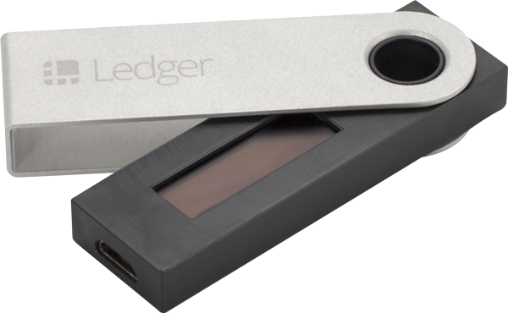

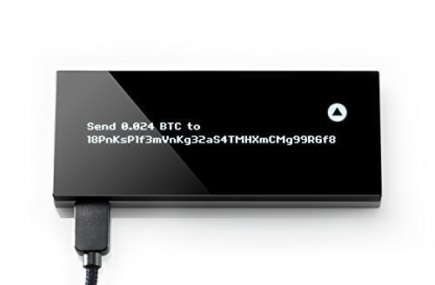
Monero Limitations
…but so close!

Slide 22



Ongoing Development
Multisig
Sub-Addresses
Translations
Lightweight
Wallet
RingCT
Optimizations
Community

Slide 23
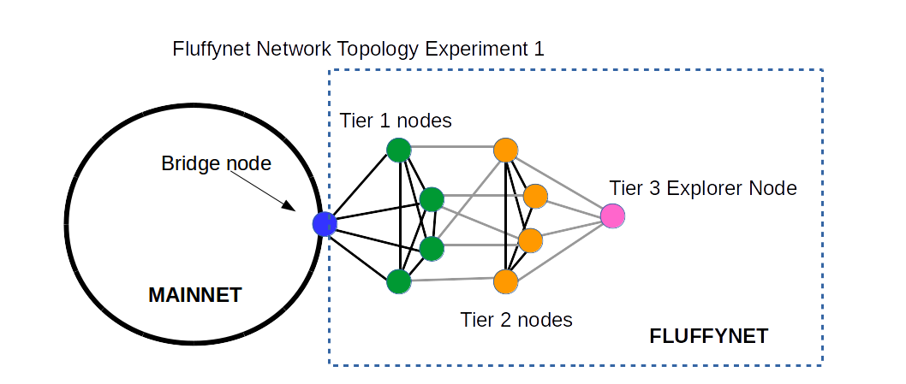
Hardfork Schedule
January
April
September
September 18th*
Mandatory RingCT
Minimum ringsize ≥5 (likely 10)
Fluffy blocks (in testing now)
Improved input selection algorithm
0MQ
Sub-Addresses

Slide 24
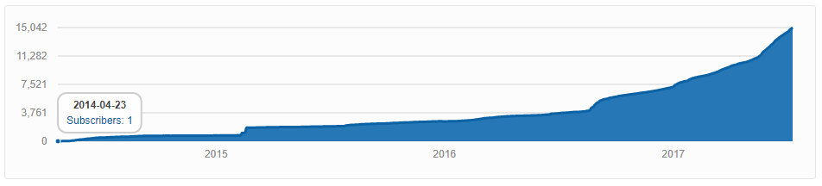
Community Growth

Slide 25
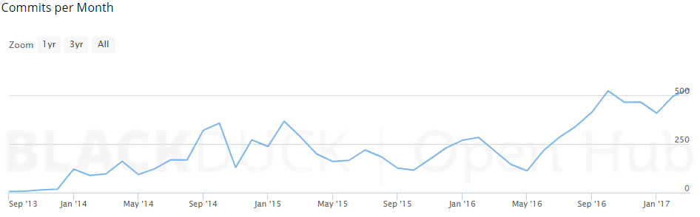
Community Growth

Slide 26
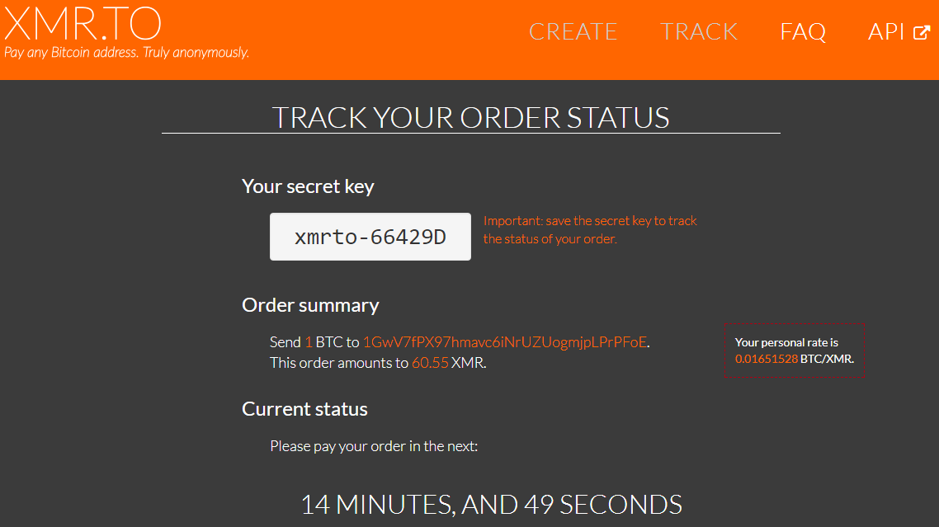
XMR.TO – Pay Bitcoin Addresses with Monero

Slide 27


Thank You!
getmonero.org
/r/Monero
monero.stackexchange.com
justin@ehrenhofer.org

